Slide 1
Data 603 Statistical Modelling with Data
(Week 1)
Dr. Qingrun Zhang
Assistant Professor
Department of Mathematics and Statistics
University of Calgary

Slide 2
Who is this guy?
A fan of coding (Ph.D. in computer science, a Staff R&D Engineer in IBM Research)
Talk is cheap. Show me the code. – Linus Torvalds (Author of Linux)
By heart a mathematician (B.S. in Math)
You need to understand the underlying principle.
10 years experience in applied fields
Biological “big data”
Medical record analysis
Causal inference and other problems.
Teaching philosophy
Fishing v.s. fishes
High-standard v.s. flexibility

Slide 3
Round table self-introduction
1. Your name
2. What kind of data are you analyzing or going to explore?

Slide 4
Course Information
Course Components (3 Assignments, 2 Quizzes, and 1 Final Project)
Assignments: 3 x 15%
Quizzes: 2 x 10%
Project: 35% = written (25%) + Presentation (10%)
Project Information (Project Checkpoint, Project Report, and Project Presentation)
Project Check Point is due on March 13 @ 11:59 pm
Final Project Report is due on March 30 @ 11:59 pm
Project presentation on April 5.
Software (R-Studio)

Slide 5
Office hour
Office hour: Friday 8:00-9:00pm
Quan Long: https://ucalgary.zoom.us/j/3585904412
Two teaching assistants: 2 different time on Tuesdays
Bita Sadeghi: bita.sadeghi@ucalgary.ca
James McCurdy: michael.mccurdy@ucalgary.ca

Slide 6

More Questions?

Slide 7

Review of simple linear regression
Input: bivariate data (X, Y) = (x_{i}, y_{i}), i=1, 2, …, n
Changes in Y are assumed to be associated with changes in X
The goal of linear regression is to model the relationship between X and Y by fitting a linear function Y = f(X)
X is called the predictor, independent or explanatory variable
Y is called the response, dependent or explained variable

Slide 8
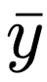
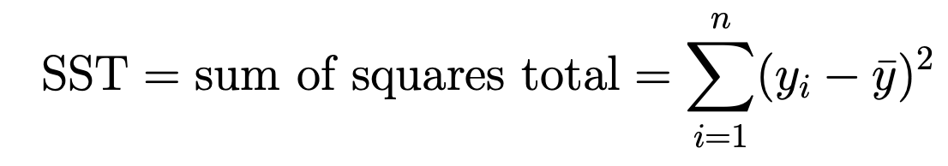
Toddler Height Example
Height(cm)
82.1
81.8
78.1
78.8
78.2
87.2
75
82.8
79.7
81.1
76.1
81.2

Slide 9
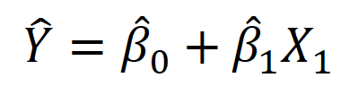
Toddler Height Example
Age(months) | Height(cm)
24 | 82.1
27 | 81.8
20 | 78.1
22 | 78.8
21 | 78.2
29 | 87.2
19 | 75
28 | 82.8
23 | 79.7
25 | 81.1
18 | 76.1
26 | 81.2

Slide 10
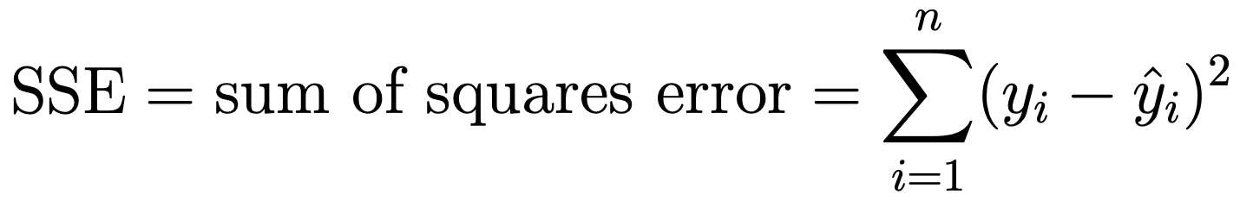
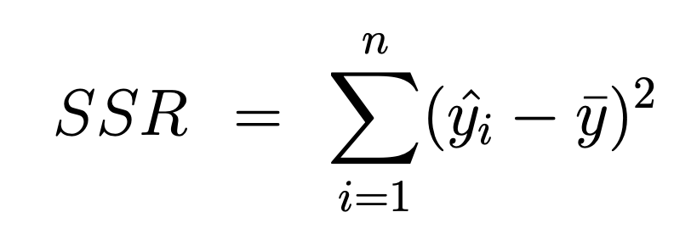
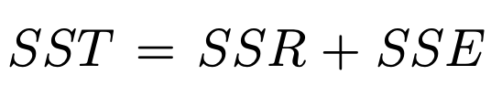
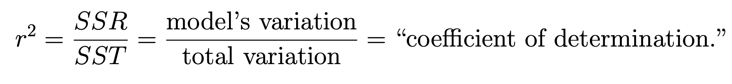
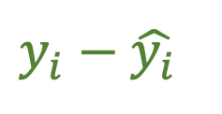
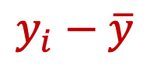
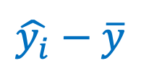
$$y_{i}−\hat{y_{i}}$$
$$y_{i}−\overline{y}$$
$$\hat{y_{i}}−\overline{y}$$

Slide 11
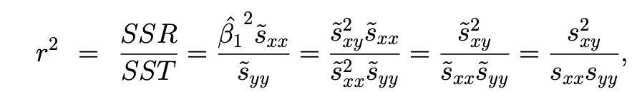
R² is the sample correlation coefficient
That is, r² tells you how much better a regression line is compared to fitting with a flat line at the sample mean .

Slide 12
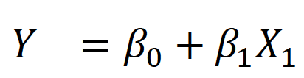
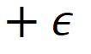
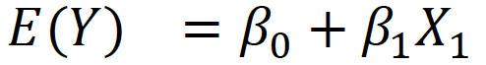
Response = intercept + slope * predictor + error
Y = β₀ + β₁ * X + ε
Population Regression Model
Regression Equation

Slide 13
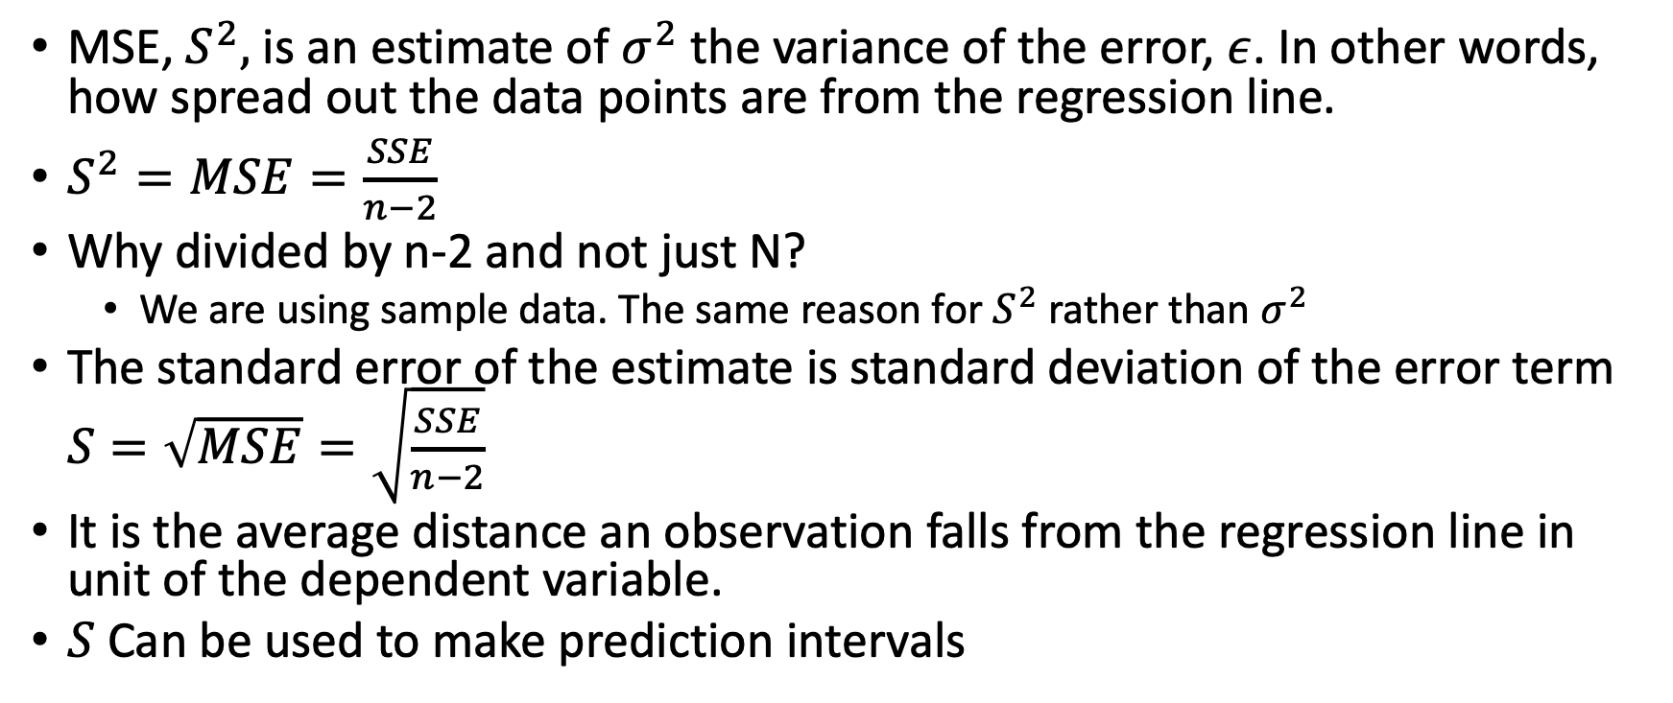
Mean Square Error
MSE, $S^{2},$ is an estimate of $σ^{2}$ the variance of the error, $ε$. In other words, how spread out the data points are from the regression line.
$S^{2}=MSE=\frac{SSE}{n−2}$
Why divided by n-2 and not just N?
We are using sample data. The same reason for $S^{2}$ rather than $σ^{2}$
The standard error of the estimate is standard deviation of the error term $S=\sqrt{MSE}=\sqrt{\frac{SSE}{n−2}}$
It is the average distance an observation falls from the regression line in unit of the dependent variable.
$S$ Can be used to make prediction intervals

Slide 14
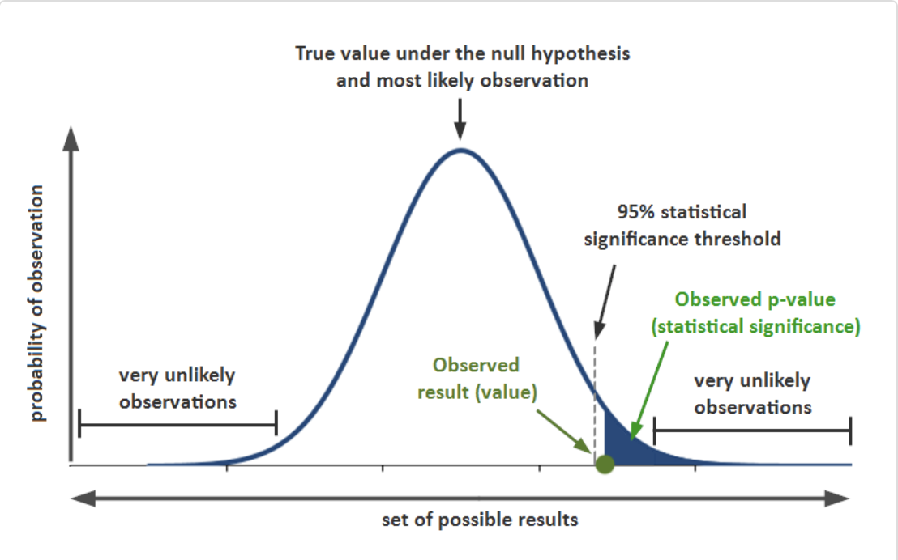
What is p-value?
What is alpha level?
https://www.simplypsychology.org/p-value.html

Slide 15
A few concepts to know
P-value: In null hypothesis significance testing, the p-value is the probability of obtaining test results at least as extreme as the results actually observed, under the assumption that the null hypothesis is correct.
An alpha level is the probability of a type I error, or rejecting the null hypothesis when it is true.
A beta level, is the opposite; the probability of of accepting the null hypothesis when it's false.

Slide 16
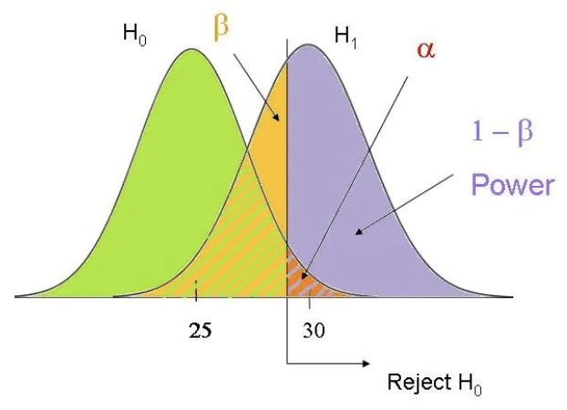
https://www.theanalysisfactor.com/confusing-statistical-terms-1-alpha-and-beta/

Slide 17
Multiple Linear Regression
No | tv | radio | newspaper | sale
1 | 230.1 | 37.8 | 69.2 | 22.1
2 | 44.5 | 39.3 | 45.1 | 10.4
3 | 17.2 | 45.9 | 69.3 | 9.3
4 | 151.5 | 41.3 | 58.5 | 18.5
5 | 180.8 | 10.8 | 58.4 | 12.9
6 | 8.7 | 48.9 | 75 | 7.2
7 | 57.5 | 32.8 | 23.5 | 11.8
8 | 120.2 | 19.6 | 11.6 | 13.2
9 | 8.6 | 2.1 | 1 | 4.8
10 | 199.8 | 2.6 | 21.2 | 10.6

Slide 18
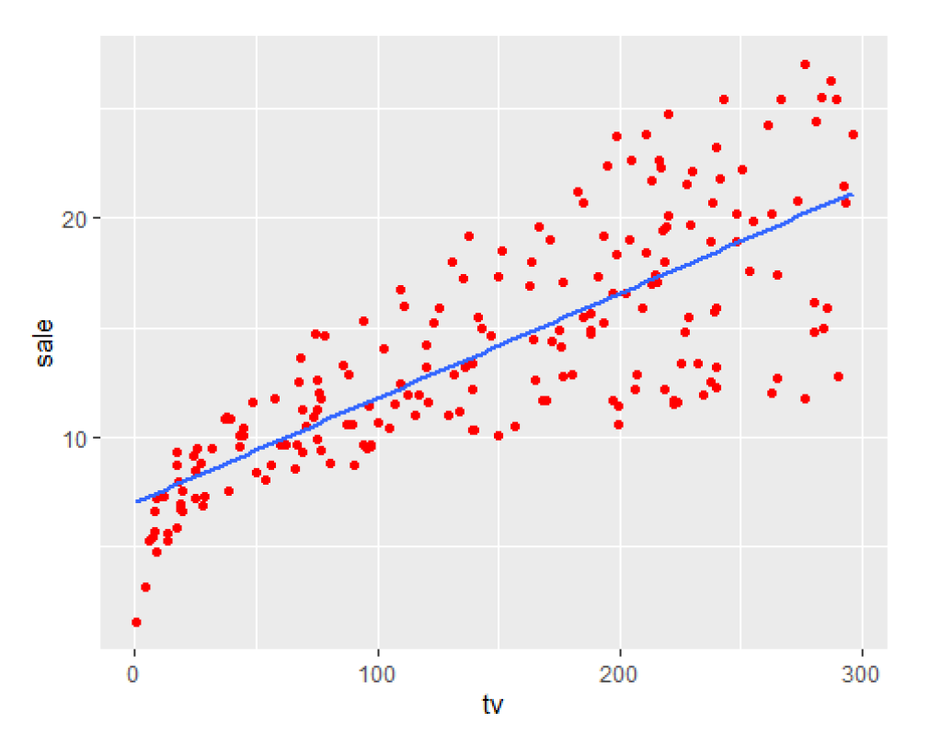
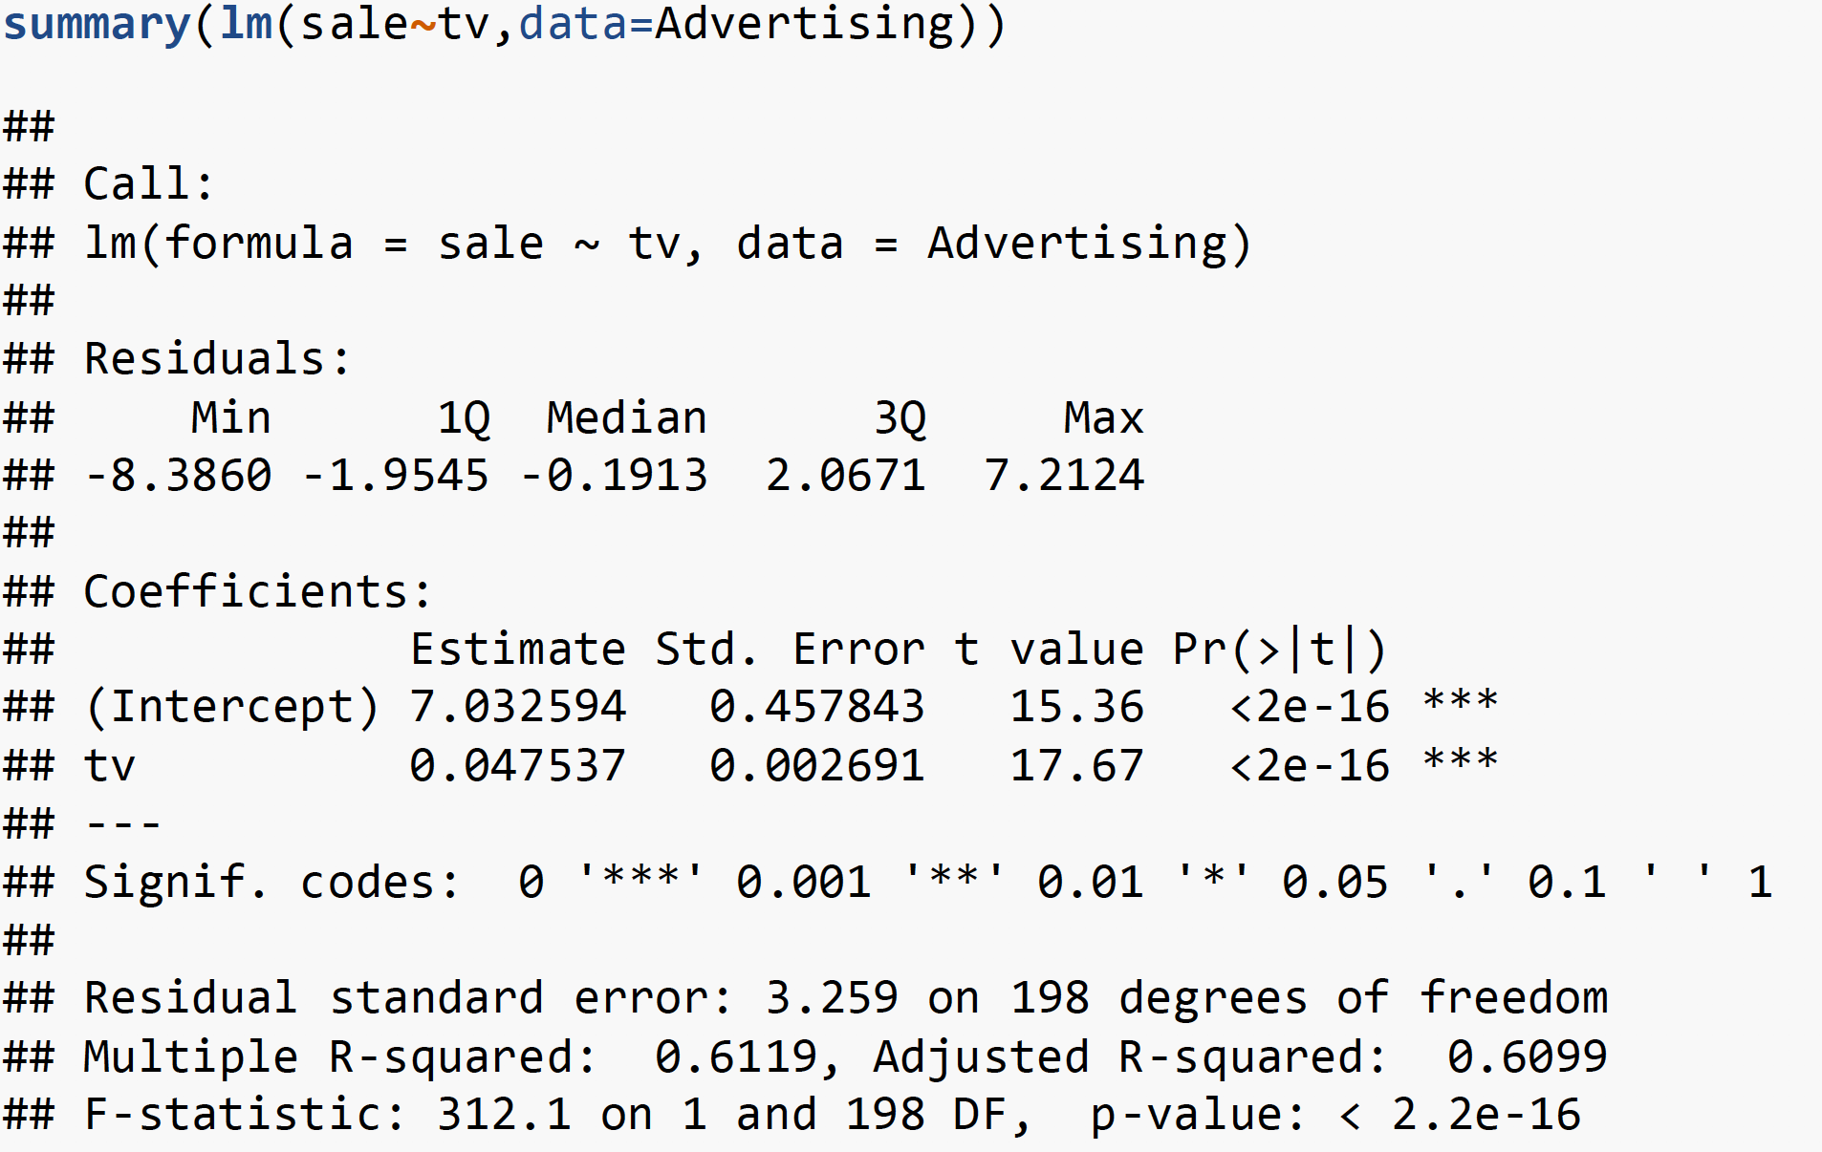
Advertising data TV vs Sale

Slide 19
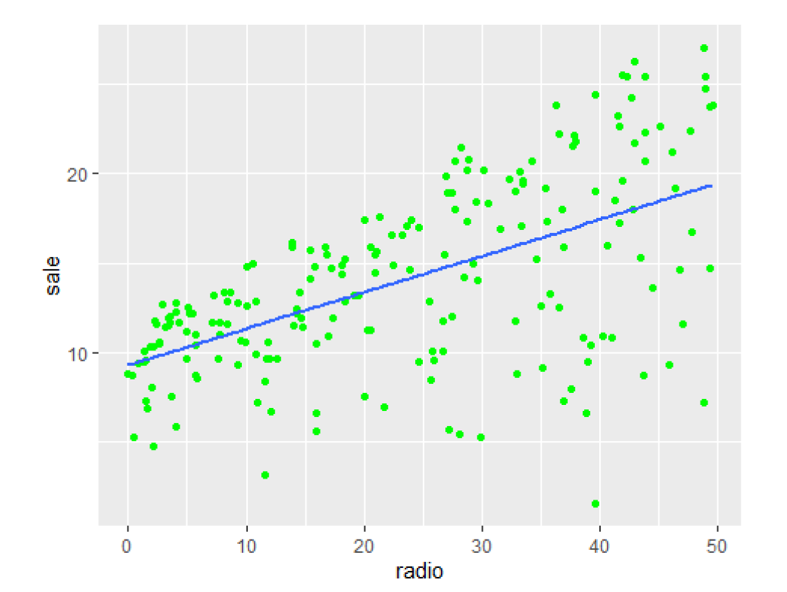
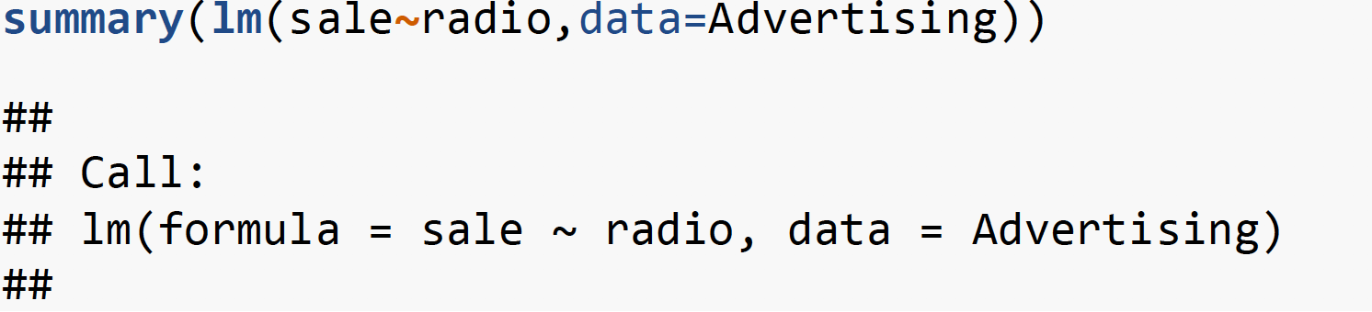
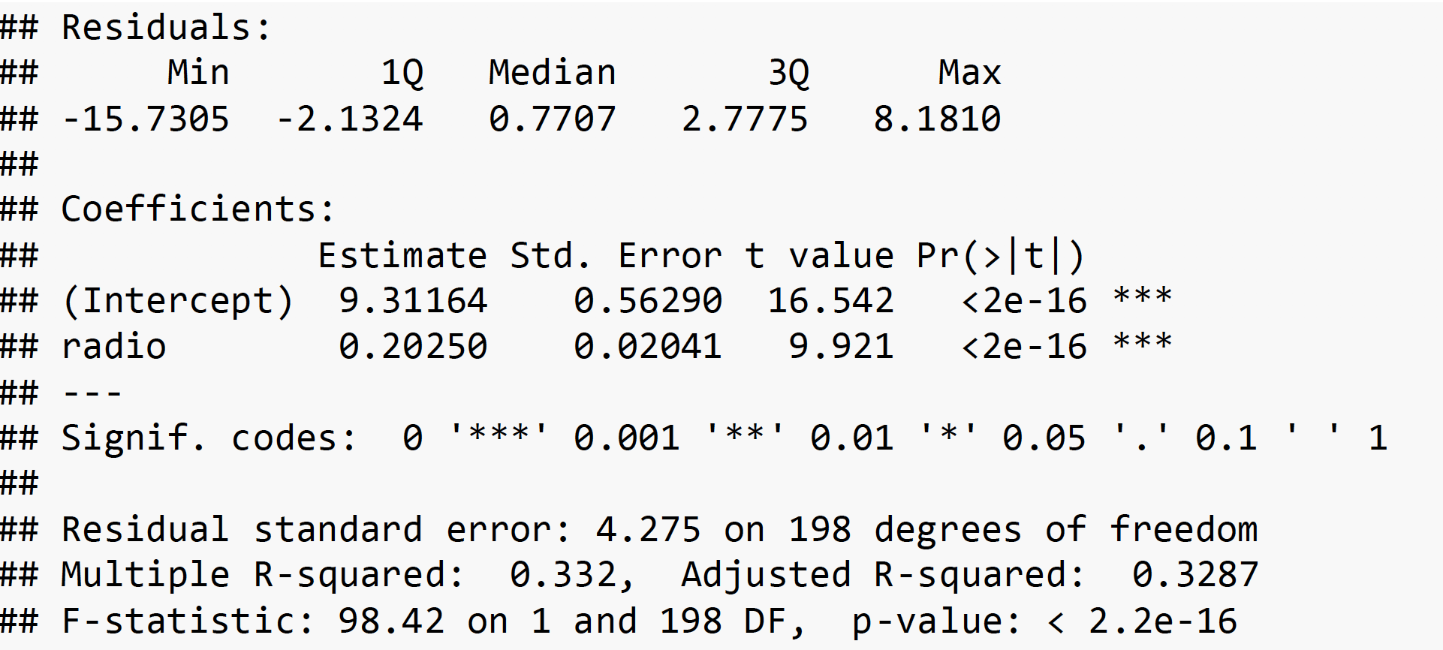
Radio vs Sale

Slide 20
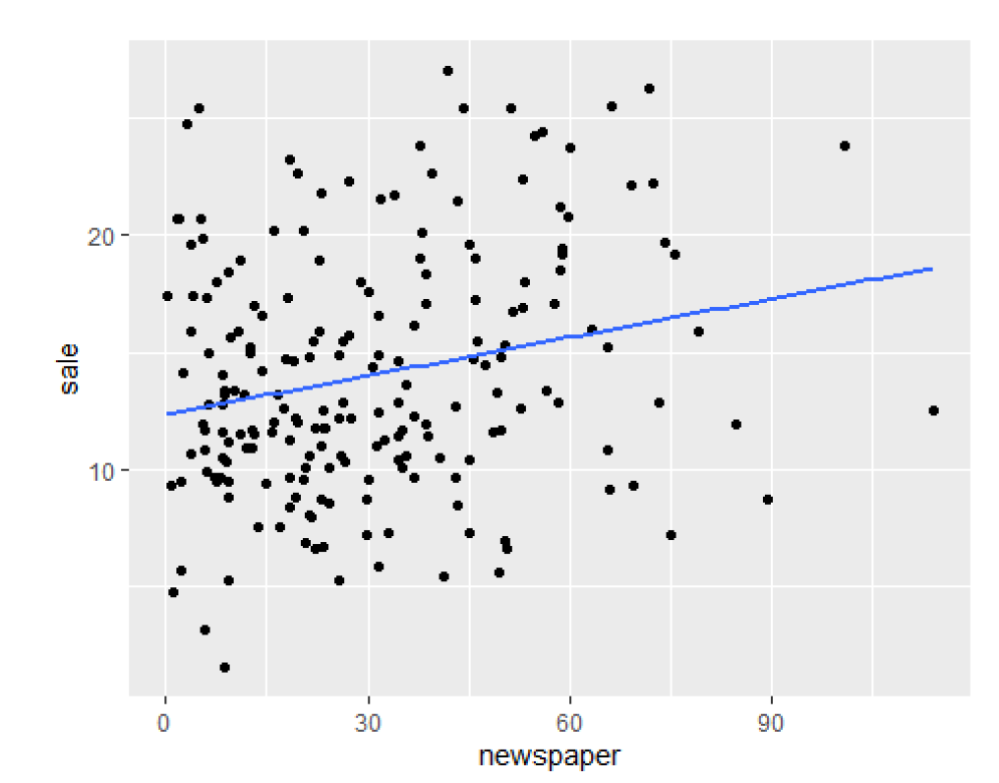
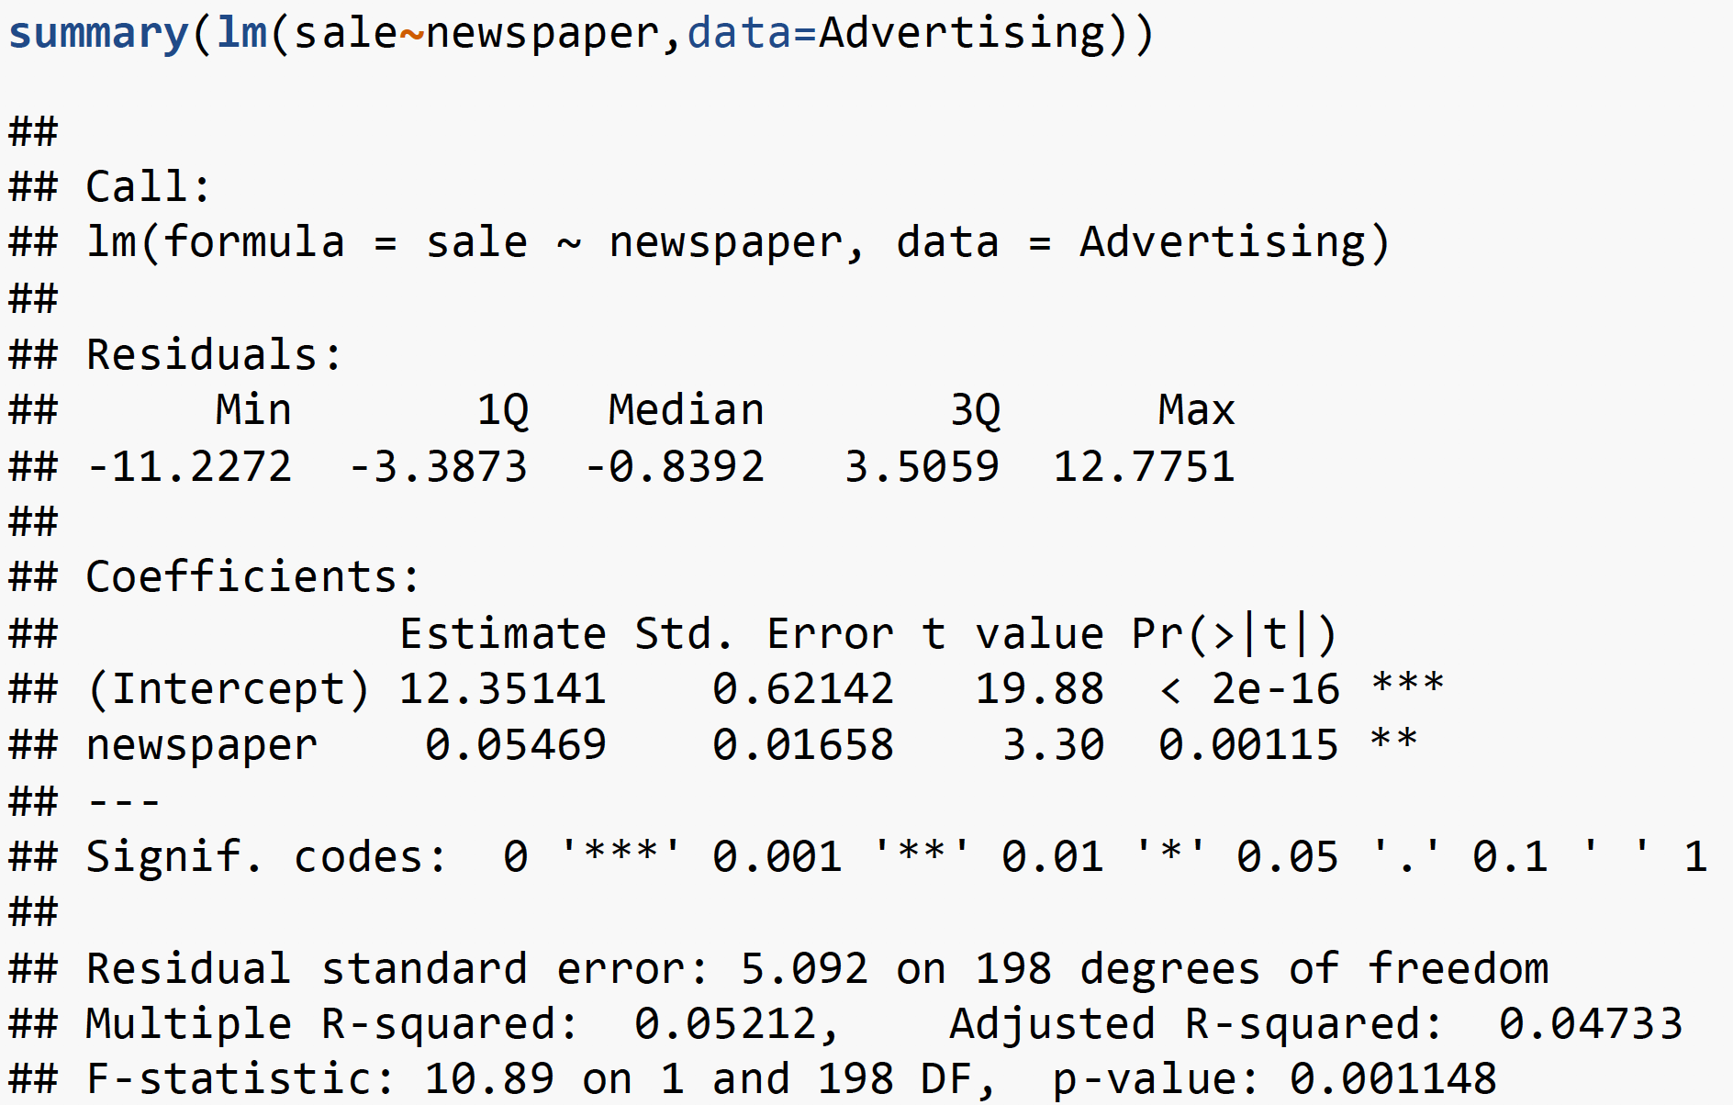
Newspaper vs Sale

Slide 21
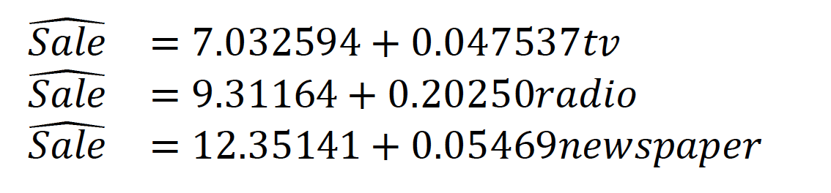
Advertising data
Which model is the best?

Slide 22
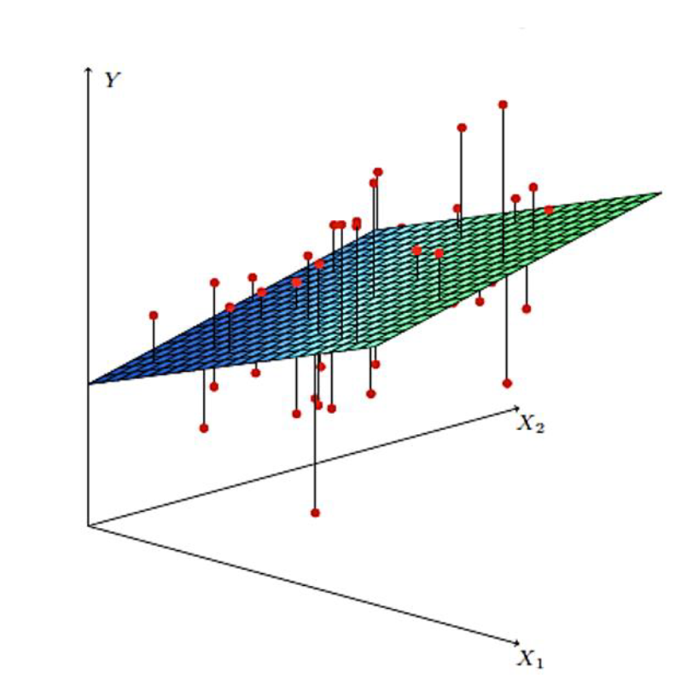
Multiple Linear Regression

Slide 23
Multiple Linear Regression
A Regression with two or more independent variables is called Multiple Regression
It is more difficult to choose the best model, since several reasonable candidates may exist.
It is more difficult to visualize what the best fitted model looks like (especially if there are more than two independent variables), since it is not possible to plot either the data or the fitted model directly in more than three dimensions.
Computations are virtually impossible without access to a high-speed computer and a reliable packaged computer program.

Slide 24
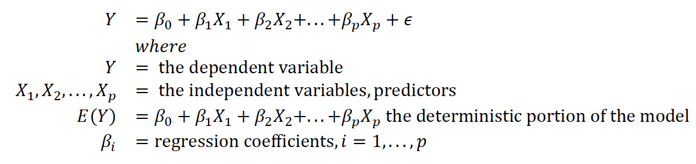
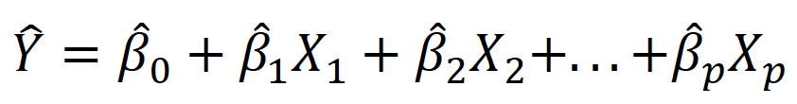
Multiple Linear Regression

Slide 25
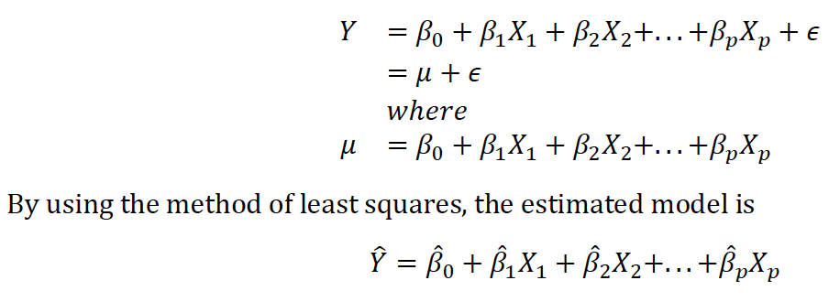
Point estimates of regression parameters

Slide 26
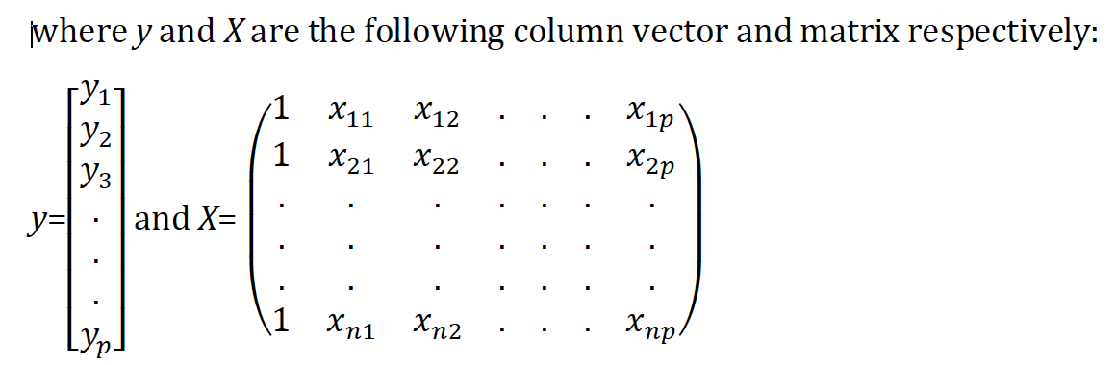
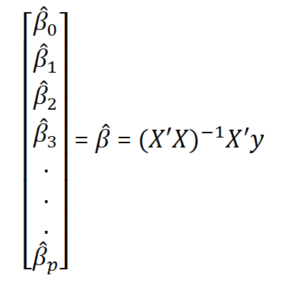
Least square point estimation

Slide 27
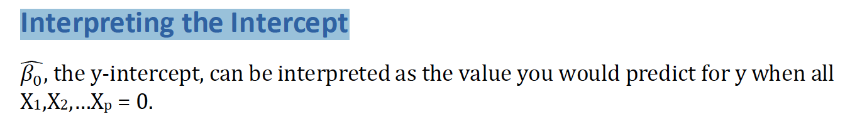
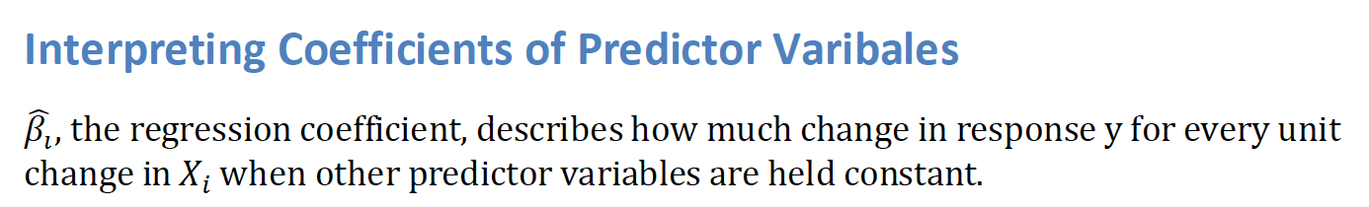
Interpreting the results

Slide 28
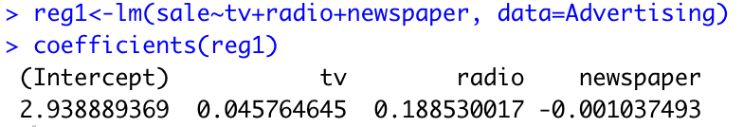
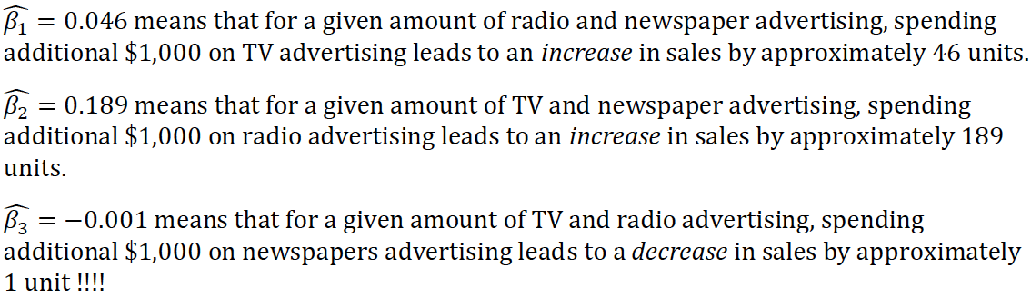
Point Estimation: Advertising data

Slide 29
Objectives of regression
To establish a relationship between independent variable with depend variable.
This is also called “association”
To forecast new observations
This is called “prediction”.
They are somewhat related however not the same!

Slide 30
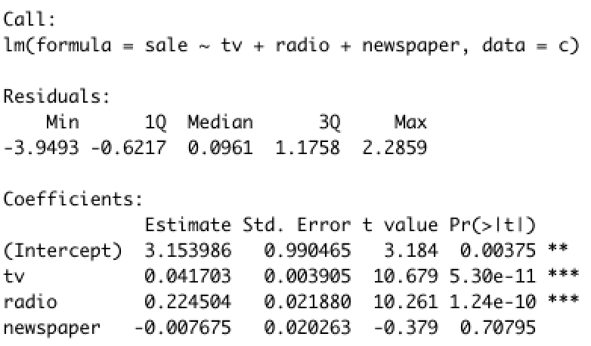
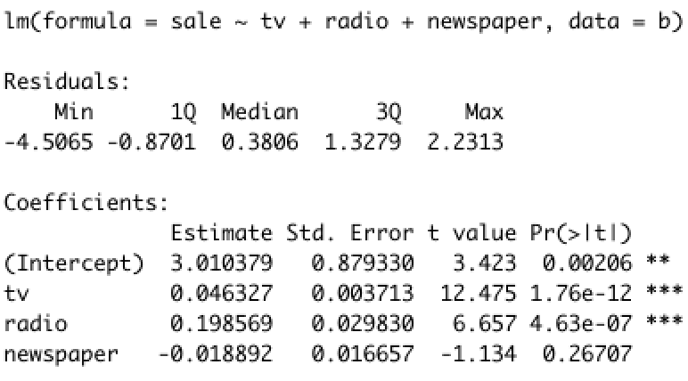
Interval Estimate for Multiple Regression Coefficients

Slide 31
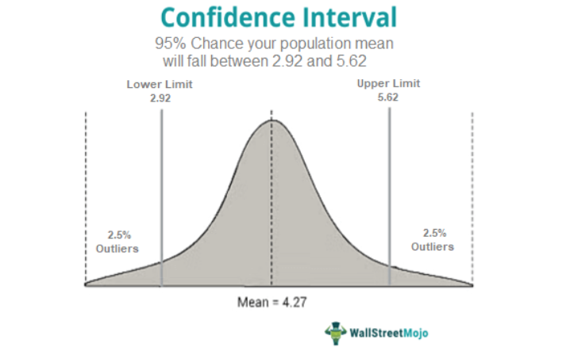
Confidence interval
Which term follows this distribution?
What is the distribution?
https://www.wallstreetmojo.com/confidence-interval/

Slide 32
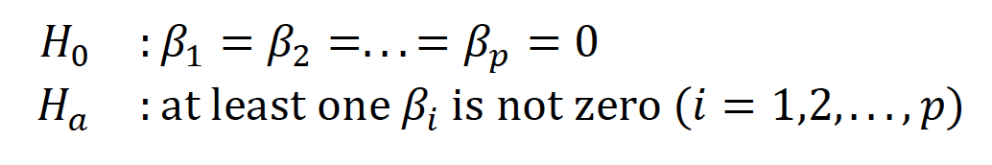
Evaluating Overall Model Utility
Full Model Test

Slide 33
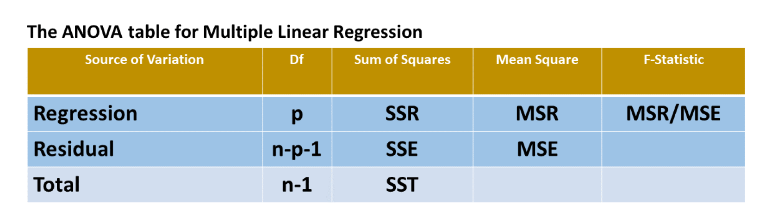
The Analysis of Variance for Multiple Linear Regression

Slide 34
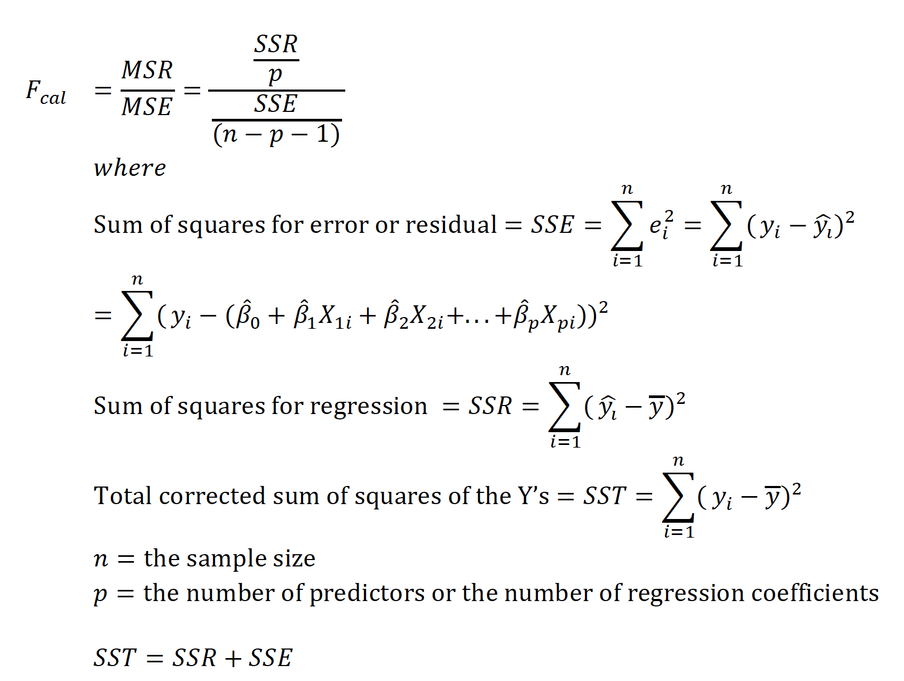

Slide 35
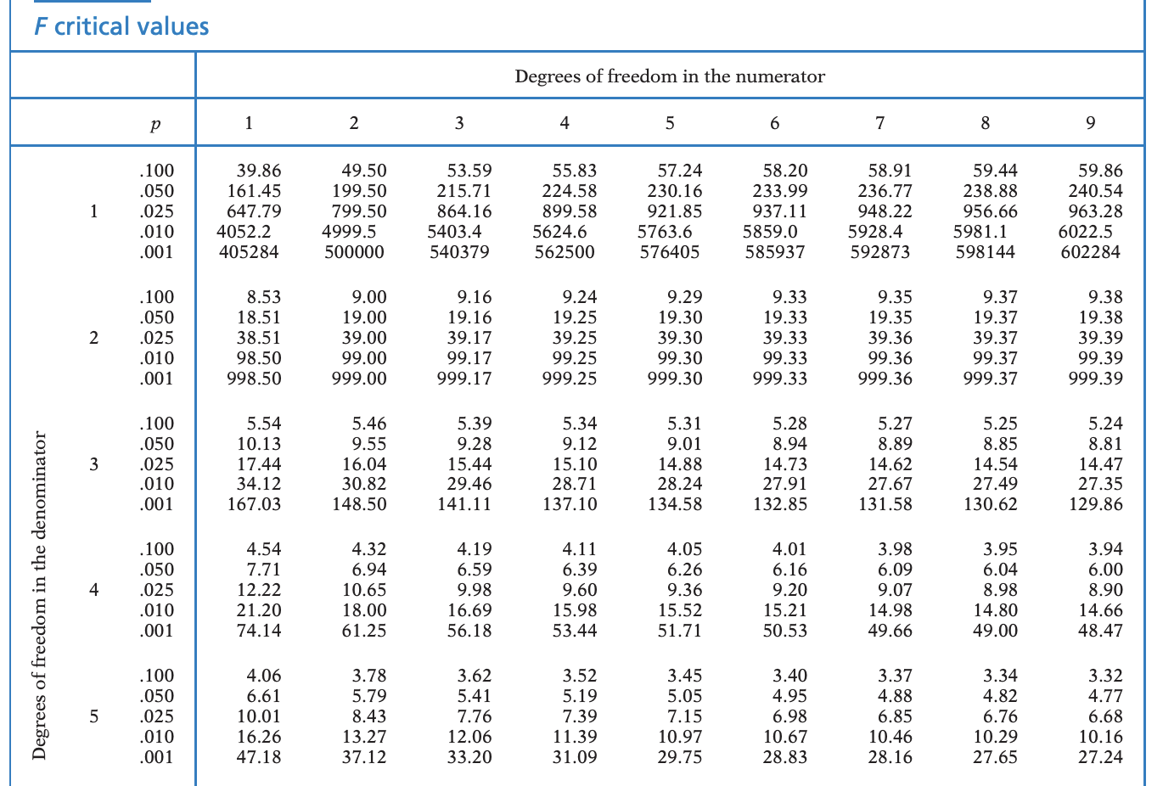

Slide 36
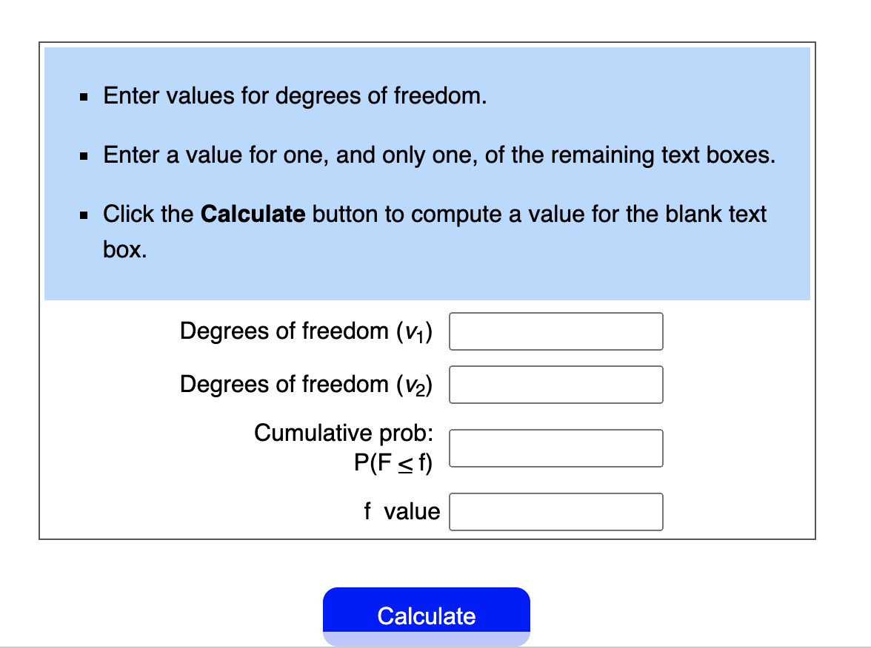
https://stattrek.com/online-calculator/f-distribution.aspx

Slide 37
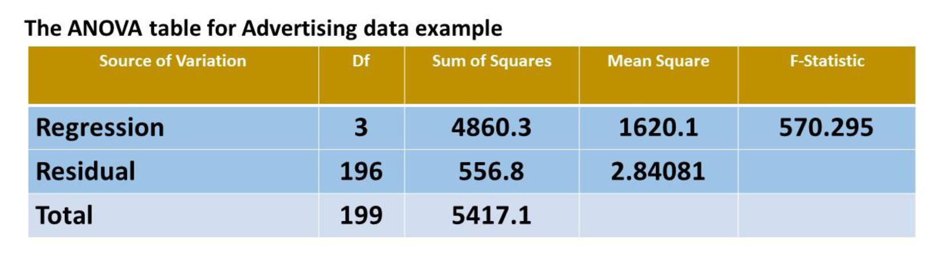
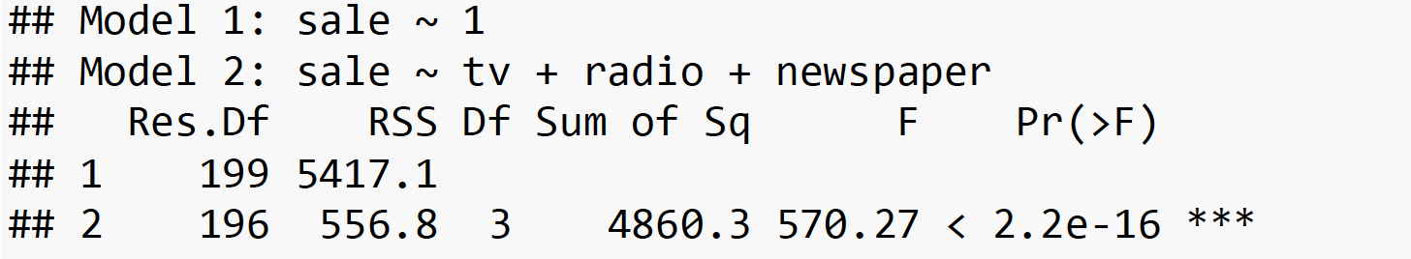
ANOVA table for advertising data

Slide 38
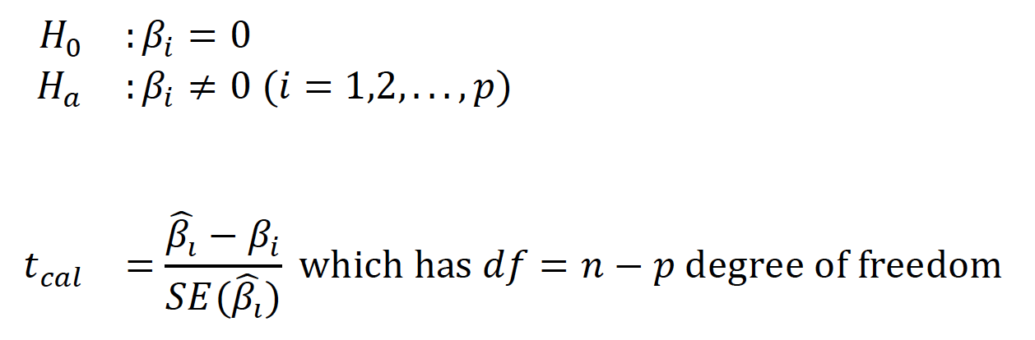
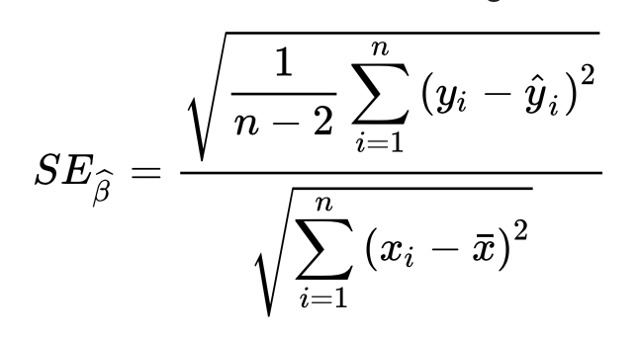
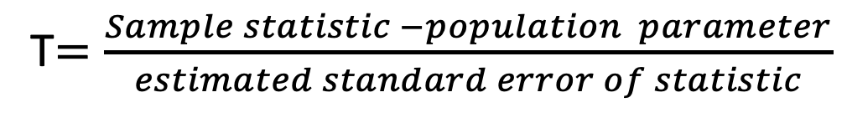
Partial Test Individual Coefficients Test (t-test)
T$=\frac{Sample statistic −population parameter}{estimated standard error of statistic}$

Slide 39
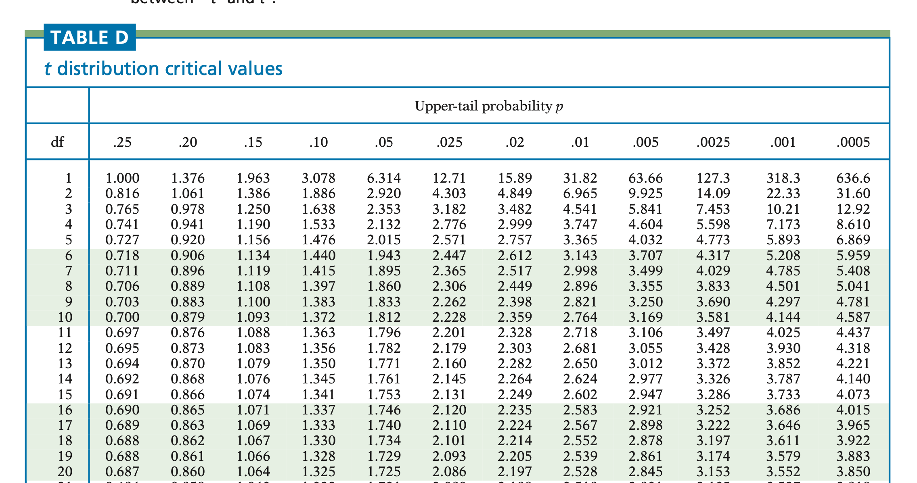
https://www.dropbox.com/s/vt3r7iy38ina018/Screen%20Shot%202021-02-18%20at%2003.07.56.png?dl=0

Slide 40
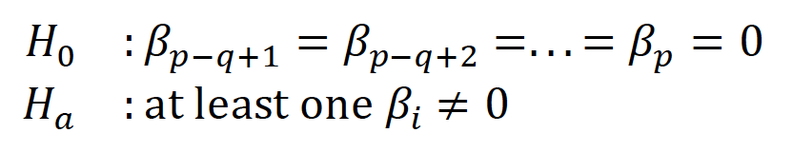

Partial F test

Slide 41

Advertising data

Slide 42

Advertising data
From the Advertising example, after dropping the variable newspaper off the full model, the reduced output shows that

Slide 43
Model Fit
𝑅² (Coefficient of Determination), the fraction of variation explained.
RSE (Residual Standard Error: 𝑠)

Slide 44


𝑅² (Coefficient of Determination)

Slide 45


RSE (Residual Standard Error: 𝑠)
The Residual Standard Error (RSE) is the square root of
$RSE=\sqrt{\frac{SSE}{n−p−1}}$

Slide 46



SER, RSE, RMSE
$$RSE=\sqrt{\frac{SSE}{n−p−1}}$$
$$RMSE=\sqrt{\frac{SSE}{n}}$$

Slide 47

Model Prediction

